Slide 1
Correcting Overfitting in Decision Trees
Bagging and Random Forest

Slide 2
Decision Trees Pros and Cons
Pro: Very easy to interpret (we can literally print out the tree!)
Cons: Unfortunately, trees generally do not have the same level of predictive accuracy as some of the other regression and classification approaches seen (LDA, Logistic etc.)
However, by aggregating many decision trees, using methods like bagging, random forests, and boosting, the predictive performance of trees can be substantially improved.
These methods of combining weak models to make strong ones are called ensemble methods.

Slide 3
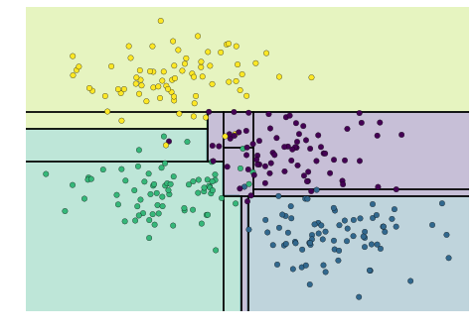
To re-cap...
Decision trees tend to overfit as tree depth increases. Notice that as the depth increases, we tend to get very strangely shaped classification regions. Here is an example with a depth of 5 (5 splits on the data)

Slide 4
The precise problem?
The exact problem is one of variance as we discussed, since decision trees want naturally grow until the leaf node is completely pure where there will be very few observations left.
A la KNN, we know that averaging a set of observations reduces variance. So, we know that theoretically, combining decision trees will reduce my variance. In other words, we could calculate fˆ¹(x),fˆ²(x),...,fˆ^{B}(x) using B separate training sets, average the models and get a low-variance outcome. THIS IS CALLED BAGGING.
But how do we build multiple decision trees? We generally do not have access to multiple training sets.
What we can do instead is called bootstrapping.

Slide 5
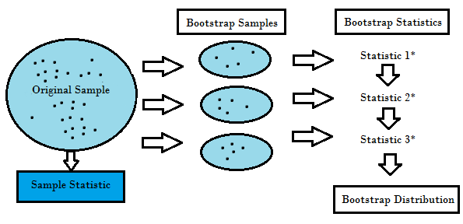
Bootstrapping: A re-sampling method
Bootstrapping is the process of taking repeated samples from a single training data set.

Slide 6
Back to Bagging...
The key to bagging is that trees are repeatedly fit to bootstrapped subsets of the observations.
On average, each bagged tree makes use of around two-thirds of the observations (why?).
The remaining one-third of the observations not used to fit a given bagged tree are referred to as the out-of-bag (OOB) observations.
We can predict the response for the i^{th} observation using each of the trees in which that observation was OOB. This will yield around B/3 predictions for the ith observation. In order to obtain a single prediction for the i^{th} observation, we can average these predicted responses (if regression is the goal) or can take a majority vote (if classification is the goal).

Slide 7
Problems with Bagging?
As we have discussed, bagging typically results in improved accuracy over prediction using a single tree. Unfortunately, however, it can be difficult to interpret the resulting model since we dont know which variables are important.
Although bagged trees are much more difficult to interpret than a single tree, one can obtain an overall summary of the importance of each predictor using the RSS (for bagging regression trees) or the Gini index (for bagging classification trees)
In regression trees, we can record the amount RSS decreases due to different splits over a given predictor, averaged over all B trees. A large value indicates an important predictor. Similarly, in the context of bagging classification trees, we can add up the total amount that the Gini index is decreased by splits over a given predictor, averaged over all B trees.

Slide 8
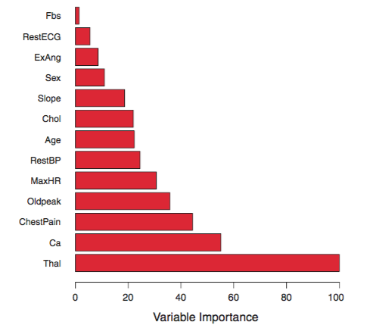
Variable importance

Slide 9
Improving Bagging: Random Forests
As in bagging, we build a number of decision trees on bootstrapped training samples. But when building these decision trees, each time a split in a tree is considered, a random sample of m predictors is chosen as split candidates from the full set of p predictors.
As a result of this randomness, the bias of the forest usually slightly increases (with respect to the bias of a single non-random tree) but, due to averaging, its variance also decreases, usually more than compensating for the increase in bias, hence yielding an overall better model.
A fresh sample of m predictors is taken at each split, and typically we choose m ≈ √p
Notes:
In other words, in building a random forest, at each split in the tree, the algorithm is not even allowed to consider a majority of the available predictors.
Suppose that there is one very strong predictor in the data set, along with a num- ber of other moderately strong predictors. Then in the collection of bagged trees, most or all of the trees will use this strong predictor in the top split

Slide 10
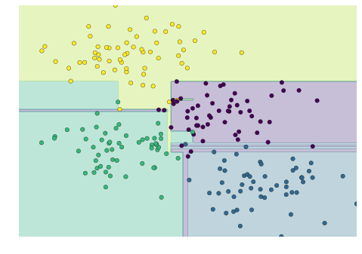
Combined Trees: A mini forest
It is clear that in some places, the two trees produce consistent results (e.g., in the four corners), while in other places, the two trees give very different classifications (e.g., in the regions between any two clusters). The inconsistencies tend to happen where the classification is less certain, and thus by using information from both of these trees, we might come up with a better result!

Slide 11
Random Forests Contd.
In other words, in building a random forest, at each split in the tree, the algorithm is not even allowed to consider a majority of the available predictors. That’s weird, why would we do that?
So, the primary impact of ensemble methods is to reduce variance by averaging.
In classification, this is achieved by majority voting and in regression by taking the mean or mode.
We can think of this process as decorrelating the trees, thereby making the average of the resulting trees less variable and hence more reliable.
Notes:
Consequently, all of the bagged trees will look quite similar to each other. Hence the predictions from the bagged trees will be highly correlated. Un- fortunately, averaging many highly correlated quantities does not lead to as large of a reduction in variance as averaging many uncorrelated quanti- ties. In particular, this means that bagging will not le

Slide 12
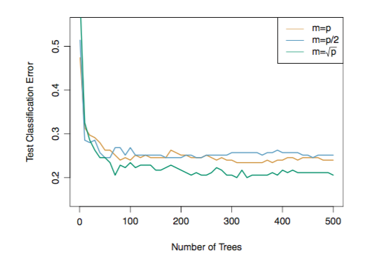
Comparing Bagging and Random Forests

Slide 13
Intro to Boosting
Recall that bagging involves creating multiple copies of the original training data set using the bootstrap, fitting a separate decision tree to each copy, and then combining all of the trees in order to create a single predictive model. Notably, each tree is built on a bootstrap data set, independent.
Boosting works in a similar way, except that the trees are grown sequentially:each tree is grown using information from previously grown trees. Boosting does not involve bootstrap sampling; instead each tree is fit on a modified version of the original data set

Slide 14
More Boosting
Unlike fitting a single large decision tree to the data, which amounts to fitting the data hard and potentially overfitting, the boosting approach instead learns slowly.

Slide 15
Gradient Boosting Steps
We fit a regular decision tree on our data. Post-fitting we have an idea of our error and in the case of regressions, we have our residuals. Then we, fit another decision tree to the residuals of the previous model.
That is, we fit a tree using the current residuals, rather than the outcome Y , as the response.
We then add this new decision tree into the fitted function in order to update the residuals.

Slide 16
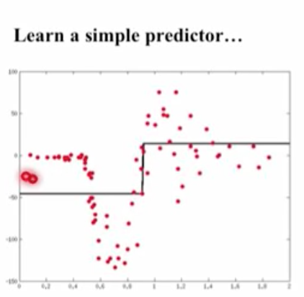
Step 1: Fit a model using Decision Tree Regressor
This will not result in a great model and is to simple to fit the shape of the data

Slide 17
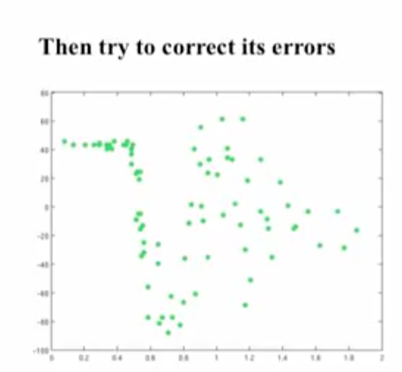
Step 2: Calculate and Print the Residuals

Slide 18
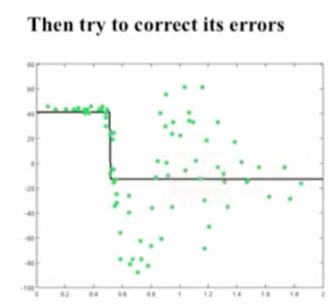
Step 3: Fit models to residuals (Not Y)

Slide 19
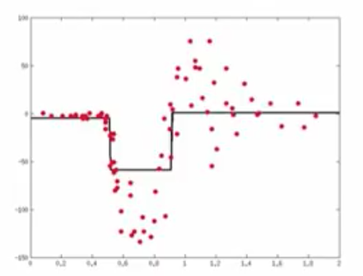
Combine predictors, Lets see what we have so far...

Slide 20
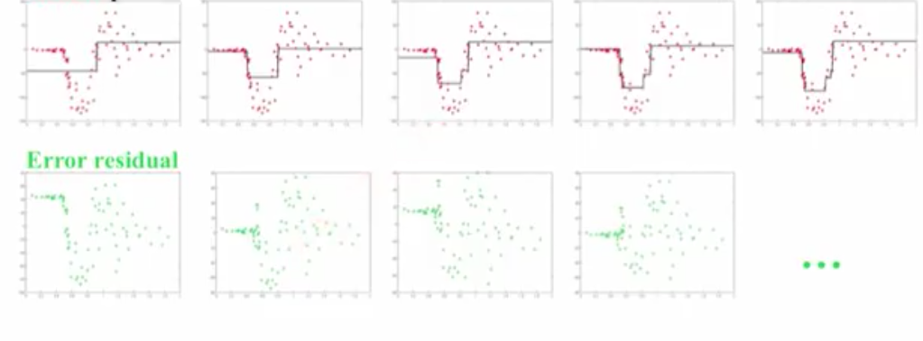
A few iterations show that….

Slide 21
So, whats going on under the hood?
First we make a set of predictions y_pred_{i}
The total error per observation cab described by the following cost function J(y_actual,y_pred) = MSE = ∑ (y_actual - y_pred)²
If we want to learn from our errors and adjust the y_pred, we need some measure of change
So if we take the derivative of J(y,y_pred) with respect to y_pred, what will we get f(i) = (y_actual - y_pred). This gives us the error residual, so now our new y_pred* is the old y_pred plus (or minus) my error residual.
Y_pred_new = y_pred + alpha* f(i)
Alpha is a constant and called the learning rate, it controls the rate on convergence to the minimum

Slide 22
Boosting has three tuning parameters:
1. The number of trees B. Unlike bagging and random forests, boosting can overfit if B is too large, although this overfitting tends to occur slowly if at all. We use cross-validation to select B. 2. Alpha. This controls the rate at which boosting learns. Typical values are 0.01 or 0.001, and the right choice can depend on the problem. Very small alpha can require using a very large value of B in order to achieve good performance. 3. The number d of splits in each tree, which controls the complexity of the boosted ensemble. Often d = 1 works well, in which case each tree is a stump, consisting of a single split. In this case, the boosted ensemble is fitting an additive model, since each term involves only a single variable. More generally d is the interaction depth, and controls the interaction order of the boosted model, since d splits can involve at most d variables.

